Slide 1
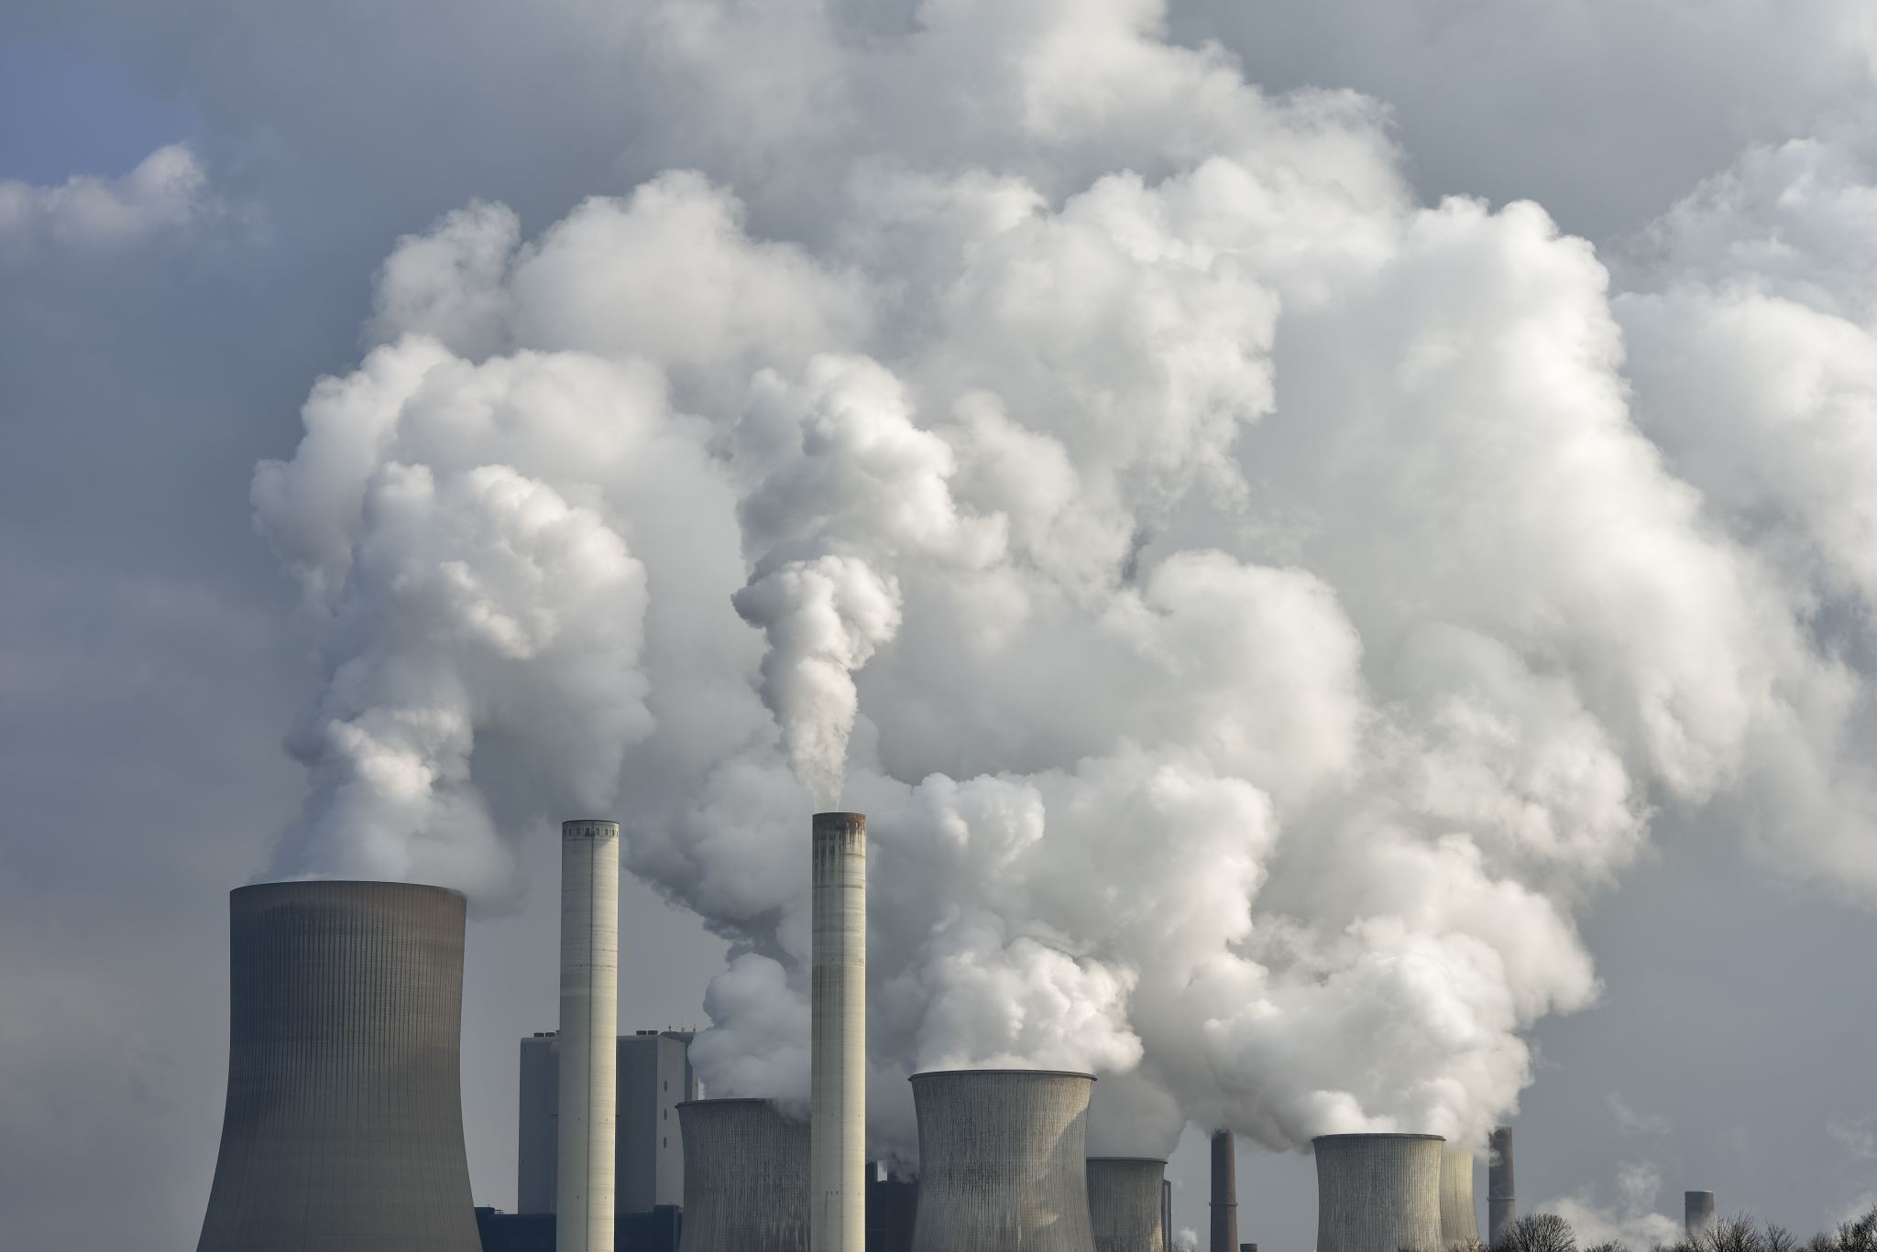

Plants versus CO₂
Does the vegetation of a specific region suffice to compensate the CO₂ emissions of this exact region?
Seminar: GIS Analyses using FOSSGIS
Lecturer: Christina Ludwig
Presented by: Niko Kolaxidis & Tobias Romes
University of Heidelberg
Notes:
- Hello and welcome to our presentation of our group project with the topic Plants vs. CO2
- with the main question ...
(- We know It's the third presentation today but we hope that we can guide you through it well)

Slide 2


Introduction
Does the vegetation of a specific region suffice to compensate the CO₂ emissions of this exact region?
1. Classification of the region: vegetated areas vs. non-vegetated areas
2. Calculation of CO₂ sequestration ability in considered area
3. Comparison of CO₂ emissions and sequestration ability
Notes:
- So let's start right away with a short introduction to the main question which can be split into 3 parts:
(weiter)
1. Vegetation... -> means classification
(weiter)
2. suffice... -> means we want to calculate ...
(weiter)
3. CO2 emissions … -> we want to compare emissions with sequetration ability and then balance the values to get an answer to the question if the vegetation is able to compensate the CO2 emissions
- The big part of the question is obviously the Classification which is a kind of GIS analysis and which basically is the essence of our group project
- And the question of course is: how do you classify a region in vegetation and non-vegetation?
- While there are different workflows for that, we chose the -> nP

Slide 3
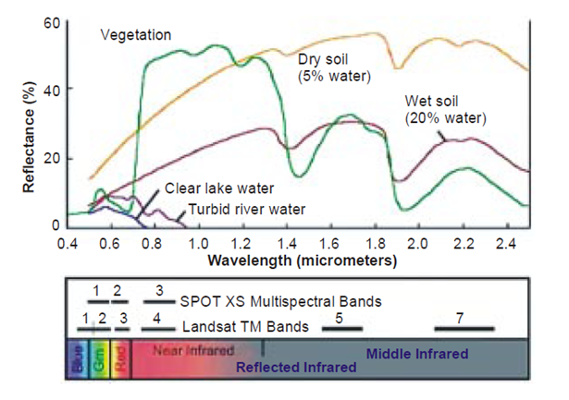
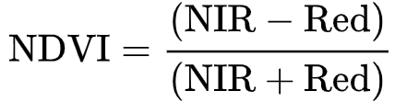
NDVI
- Normalized Difference Vegetation Index
- Unique spectral reflection of vegetation
- Calculate photosynthetic activity, vitality and density through formula:
Source: Mkansi 2017
Notes:
- NDVI abbreviation for ...
- It describes a unique difference in the spectral reflection of vegetation between two bands
- red band (around 400-700nm, weiter) and near-infrared band (around 700-1300nm, weiter)
- Note that the more photosynthetically active a plant is the higher its reflection in the near-infrared wavelenghts will get
- As you can see in the figure other elements on earths landscape don't have this exact difference in their spectral reflections
- Therefore it is quite unique to vegetation
- With help of this formula (weiter) you can calculate the NDVI which shows (weiter) the photosynthetic activity, vitality and density of objects in the landscape -> nP

Slide 4
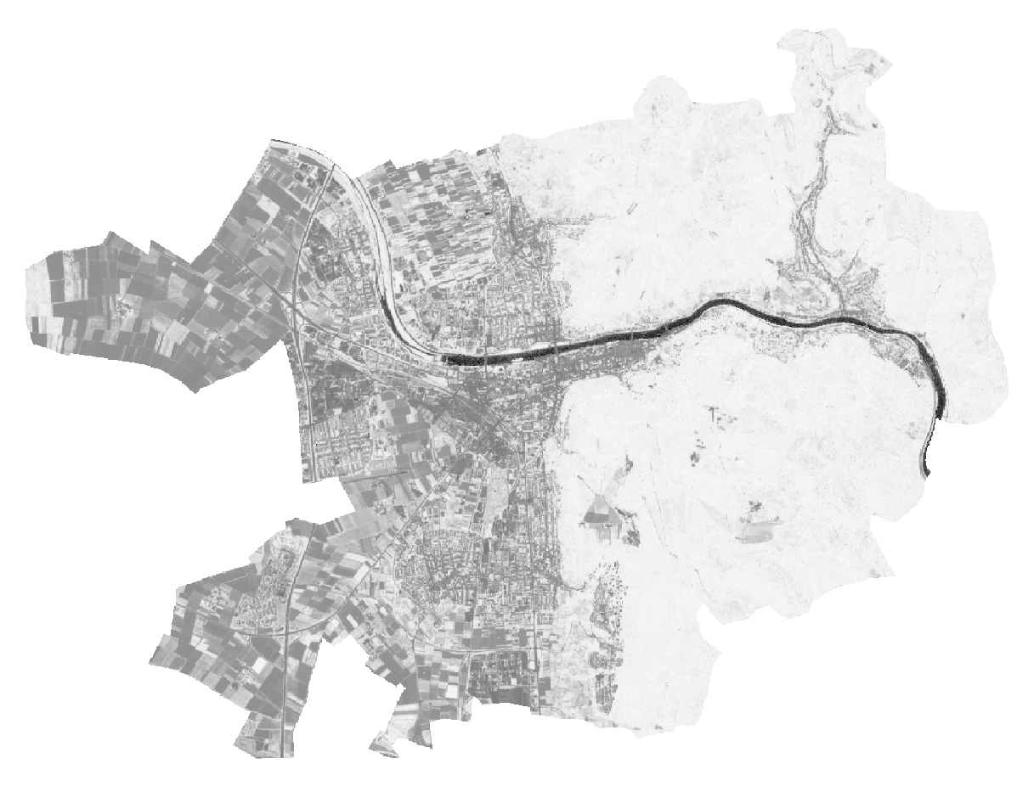
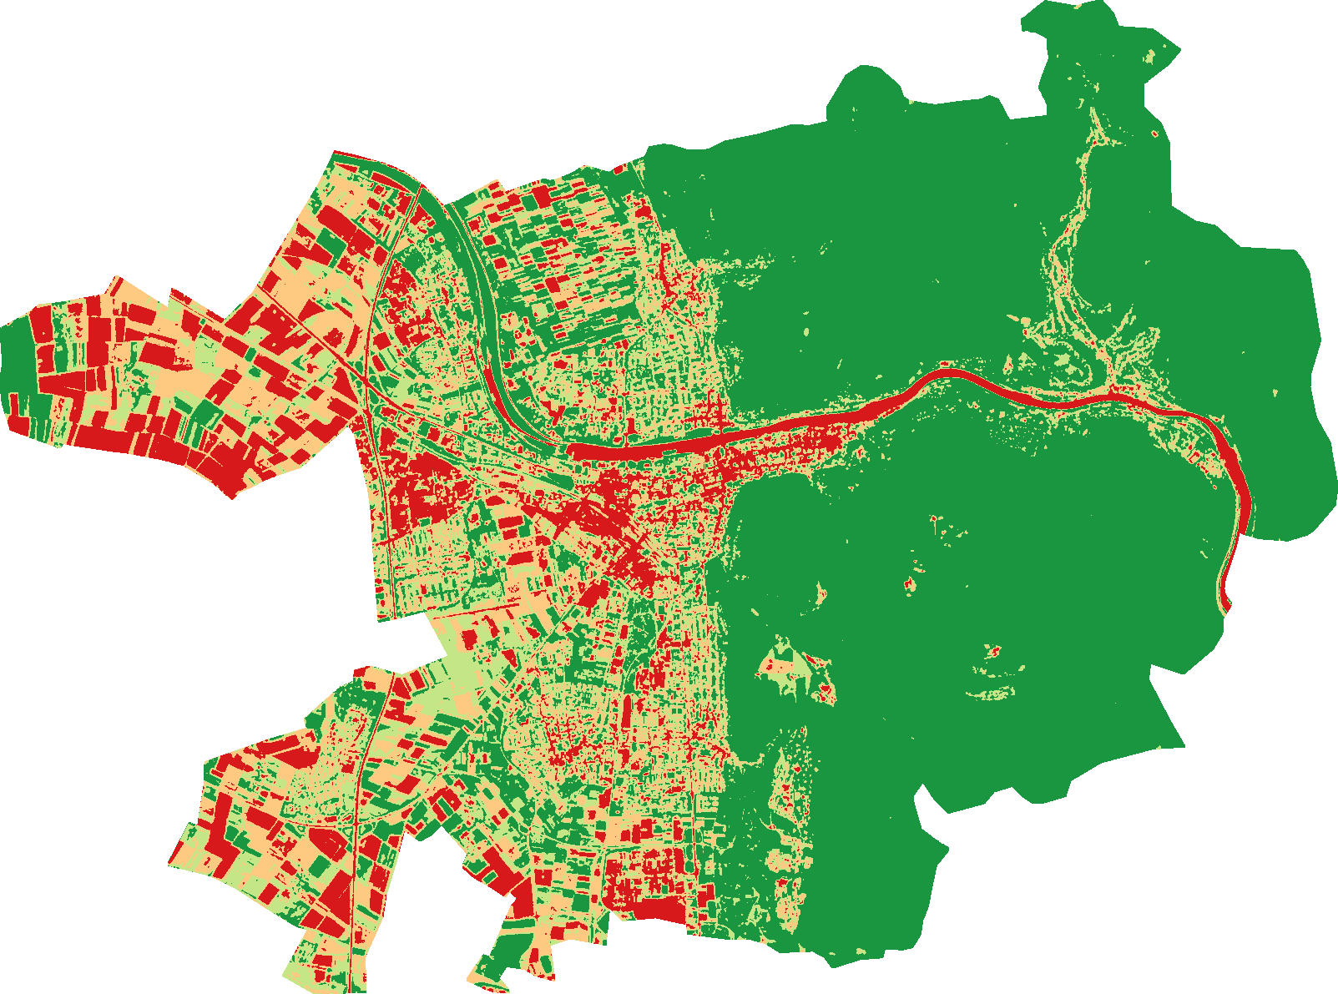
NDVI
Areas | Value
No Vegetation | -1 – 0.2
Low level of vegetation (shrub/grass) | 0.2 - 0.4
Medium level of vegetation (crops) | 0.4 - 0.6
High level of vegetation (forest) | 0.6 - 1
Source: own figure
Notes:
- If you calculate it the output looks like that, we used Heidelberg as an example.
- The index outputs a value range between –1 and 1, where the value range between 0.2 to 1 incrementally shows the said properties of vegetation.
- Every pixel with a value beneath 0.2 is basically not vegetation because its photosynthetically inactive
(weiter)
- Literature further reclassifies this value range into classes to be able to determine the location and frequency of different levels of vegetation
- We thought of using those classes to calculate the total area of the different levels of vegetation by using the frequency of pixels in a specific class
- The classes are furthermore important to calculate the total sequestration ability of vegetation because we convert this frequency of pixels into area values and correlate them with specific sequestration values depending on the levels of vegetation
- And if we color the whole reclassified thing with a predefined color definition file it looks like that
(weiter)
- So the calculation of the NDVI and its reclassification are the main tools for our task
-> nP TOBI

Slide 5
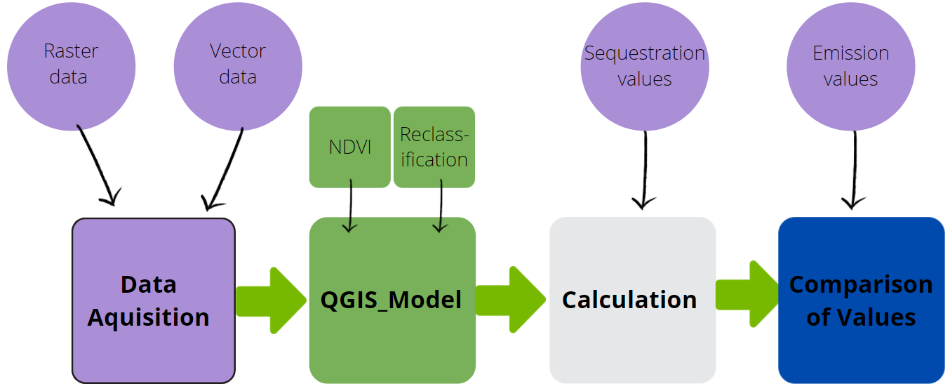
Workflow
Notes:
For obtaining NDVI different types of data such as raster and vector data are needed. This is represented graphically on the left with Data acquisition.
The NDVI calculation is actually a part of the model along with the reclassification. This is also the main part of our workflow and illustrated in green.
Right after the acquisition of the data we execute the model and then calculate the sequestration value for our area in the next step. In the end we compare those results with emission values we found in the literature.
So what do we require for running this workflow?

Slide 6
Requirements
Data:
Multispectral raster data
Vector data (city outlines)
CO₂ emission data
Annual amount of CO₂ fixed by vegetation
Software:
NDVI calculation tool
Classification tool
Spreadsheet (Excel)
Notes:
Well first of all we need data:
Then we also need some software like the …
What do we need especially? N.P.:

Slide 7
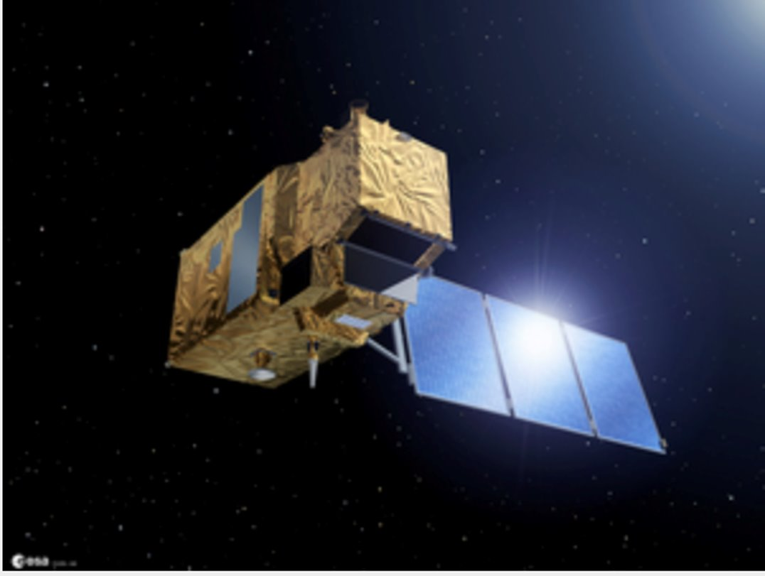
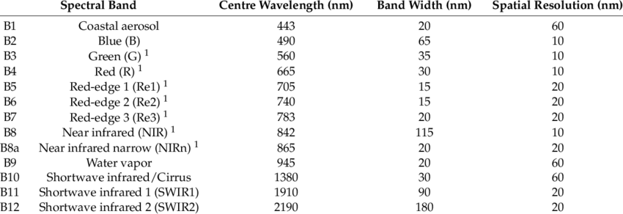
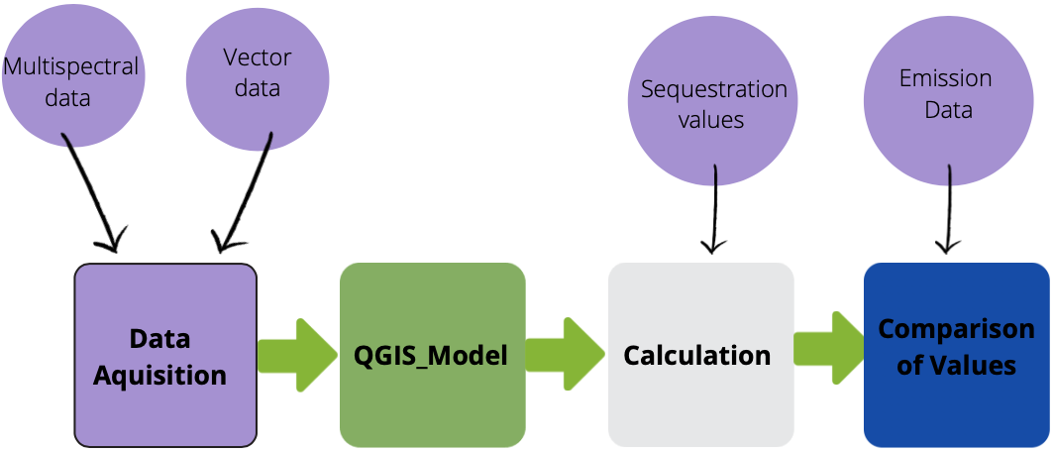
Raster data from Sentinel 2
Source: Copernicus.eu
Source: Zheng et. al (2018)
Notes:
Let´s start with raster. Well first of all:
- There are different sources of raster data for our needs, but we decided to go for Sentinel 2 data which is online available from free sources.
Why did we choose Sentinel 2?
It has a high spatial resolution of 10m. This is very good compared to raster data like Landsat 8 which ,,only´´ has a resolution of 30m.
As you can see in the above image we need the red band number 4 and the NIR band number 8 to run the NDVI.

Slide 8
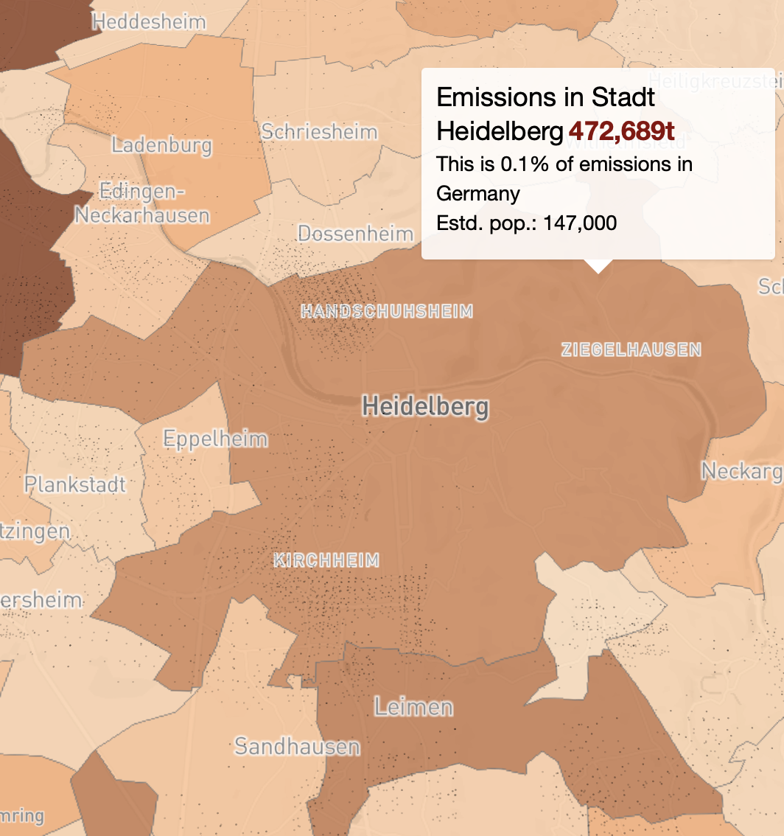
CO₂ emission data
- OpenGHGmap.net
- Available free for Europe
- Output: one value (e.g. Heidelberg: 472,689 t CO₂/year)
- Administrative level up to small towns
- Con: Data only for year 2018
Vector data
- gadm.org
- Vector data available for whole world
- Administrative level up to small towns
- Current data
- Output: Geopackage or shapefile
Source: OpenGHGMap.net
Notes:
- Additionally we need CO2 emission data -
we found the openGHGmap.net Data for Europe is for free
One value:…
You can choose data from high administrative level down to small towns.
Only Disadvantage: no up to date data
(weiter)
Furthermore we need vector data to clip the rasters to a city or region
--> gadm.org
Vetor d. for whole world
Administrative level to small towns as well
Data are up to date And thet outputs are either Geopackage or shapefile
(- Erklärung wie Werte zustande kommen: Vehicle emissions are attributed across fuel stations; train emissions at stations, aviation bunker fuel emissions at airports, and so on.
Industrial source emissions are located at the registered address where these emissions phyiscally occur or are legally controlled. Data is only available for the year 2018.)
(-The aim is to estimate an emissions inventory for each of the ~116 000 administrative jurisdictions across Europe and the UK.)
(- spatially disaggregates each country's official (Eurostat) CO2 emissions inventory to places using OSM.)

Slide 9

Extracting the region of interest (roi)
echo Enter the region of interest (roi):
set /p roi=
ogr2ogr -f "ESRI Shapefile" ./data/%roi%.shp -lco ENCODING=UTF-8 -t_srs EPSG:25832 -sql "SELECT * FROM gadm36_DEU_3 WHERE NAME_3='%roi%'" ./data/gadm36_DEU.gpkg
e.g. Heidelberg
./data/Heidelberg.shp
'Heidelberg'
Notes:
- We wrote a small script to be able to select a region of interest within the Geopackage/Shapefile.
- We already used such a command during one of the assignments, so we don't really get into deep here.
- The only special thing about it is that if you execute the "roi_extractor.bat" in the shell, thren you are asked to type in the regions´ name and it automatically puts in the command (weiter, weiter, weiter).
- It then exports this selection as a shapefile which you then can use to clip the raster data to.
-> NIKO

Slide 10
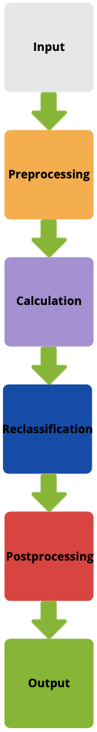
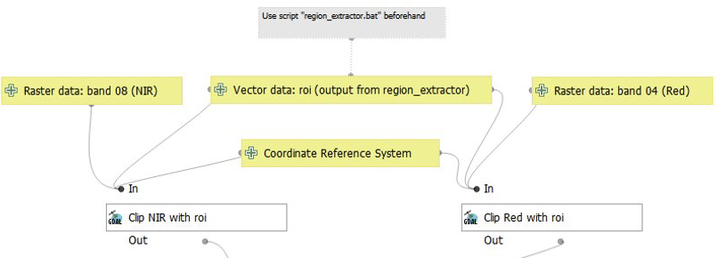
Automation: QGIS model
Notes:
- So now we have all the required data ready and can get into the QGIS model
- First we define the inputs raster, vector and crs
- And clip the rasters in a preprocessing step to minimize the data size and therefore calculation speed
- In the next step, you would want to calculate the NDVI -> nP

Slide 11
Comparison: Raster Calculator
Raster Calculator: QGIS
+ fast (2 sec for Heidelberg)
+ easy to use
-- needs to output into a file, therefore difficult to implement into Graphic Modeler
o slightly less values (pixels) → ?
Raster Calculator: SAGA
- slow (40 sec for Heidelberg)
+ easy to use
++ easy to implement into Graphic Modeler
o slightly more values (pixels) → different values
Notes:
- Best tool for that calculation: Raster Calculator (obviously)
- We have different options for the tool depending on which GIS you use
- We tried the ones from QGIS, SAGA and GRASS, but GRASS was just too difficult to handle, we just dropped it out of convenience and just compared the ones from QGIS and SAGA
- What we saw pretty soon was the difference of the calculation speed ...
- We don't know if it takes longer the larger the region gets as it is the case with the QGIS tool, we just need to test it further
- Both are easy to use but the big disadvantage of the QGIS RC is that … where the SAGA tool is very easy to implement into the Graphic Modeler because the postpressing tools can handle the algorithm output itself
- and the last thing we saw is that both tools calculate the ndvi but with slightly different values ...

Slide 12
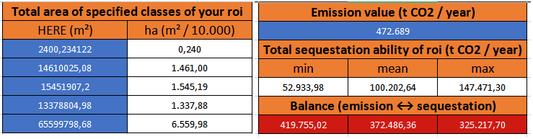
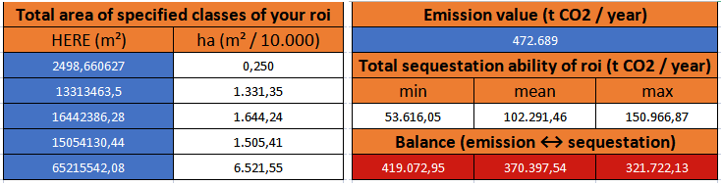
Comparison: Raster Calculator
Calculated with values from QGIS
Total: 10.904,29 ha
Source: own figure
Calculated with values from SAGA
Total: 11.002,29 ha
Source: own figure
Notes:
- Something about the values seems off, they differ a bit.
- The SAGA tool, despite calculating with exactly the same data and therefore extent, just have more hectares of data, but not too much.
- We think it's because the pixels get smoothed out a bit and then being put in two different classes although they should only be in one.
- Which you can see here -> nP

Slide 13
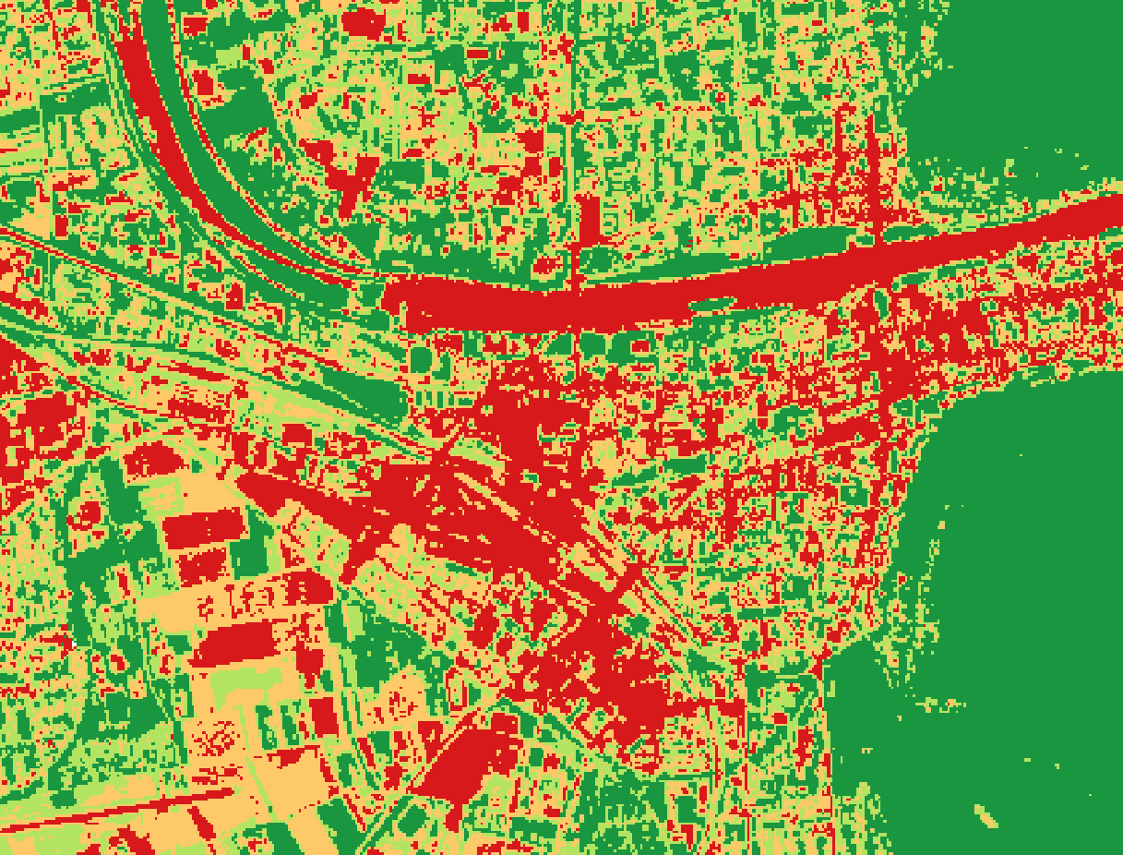
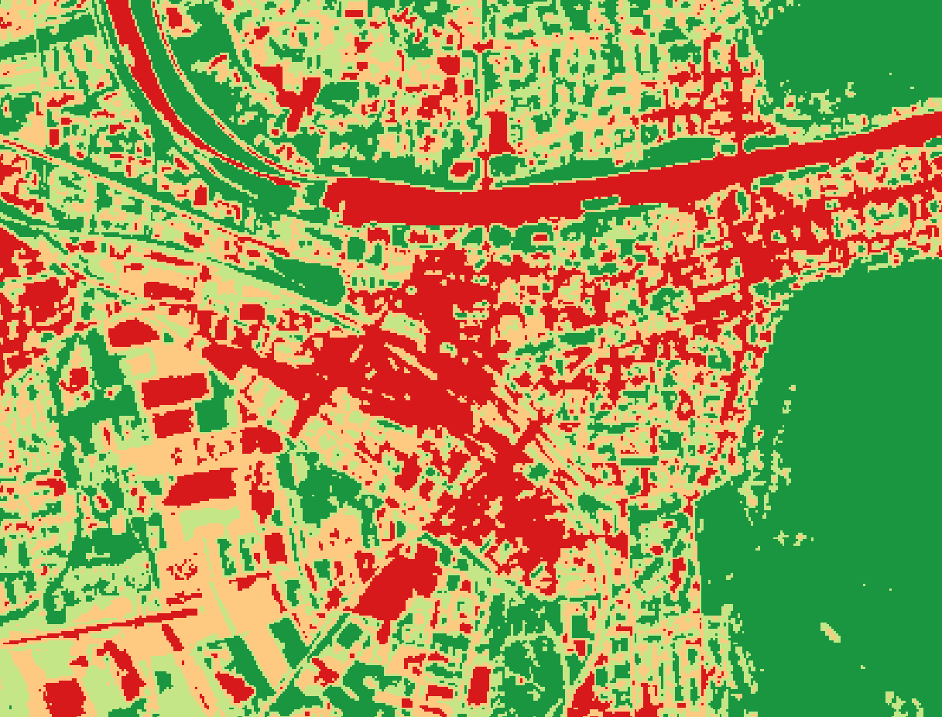
Comparison: Raster Calculator
NDVI calculated with QGIS
NDVI calculated with SAGA
Source: own figure
Source: own figure
Notes:
QGIS: pixels seems more sharp
SAGA: pixel seem like they got smoothed out a bit
- But we cannot tell which values are better because we have no comparison to those values
- QGIS might calculate the better ones because there is no alteration during the calculation as the smoothing but maybe it's better to have this alteration for the topic we have (like one tree doesn't make a huge difference)
- So in the end we just stick to the tool that is easier to implement in the Graphic Modeler, so we chose the SAGA tool
- But it's a possibility that we switch to another raster calculator when we figured out how to implement it into the Graphic Modeler

Slide 14
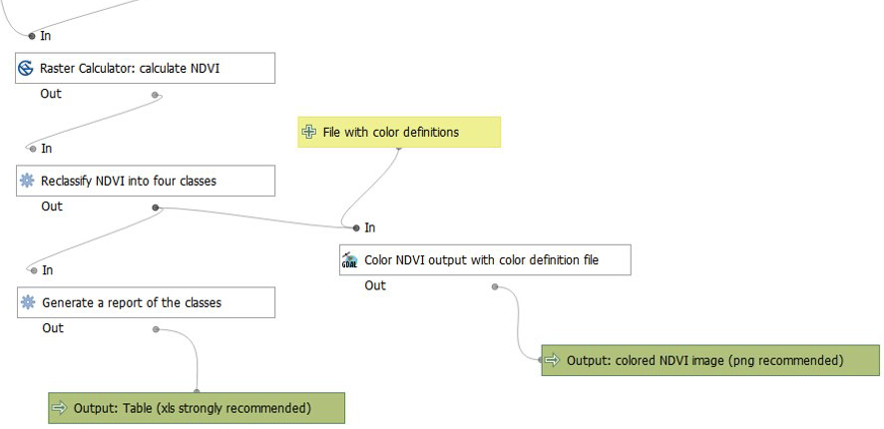
Automation: QGIS model
Notes:
- So we calculated the NDVI (weiter) with the Raster Calculator (weiter)
- Reclassify the NDVI (weiter) in four classes as shown before
- And then want to (weiter) postprocess the values and the ndvi calculation
- We thought of two outputs (weiter):
1. Generation of a report of the classes -> Excel file with values
2. Colored NDVI with a color definition file as seen before (red to green) just to check if everything went right and just to get visualization of what happened and how the vegetation situation of your roi looks like

Slide 15
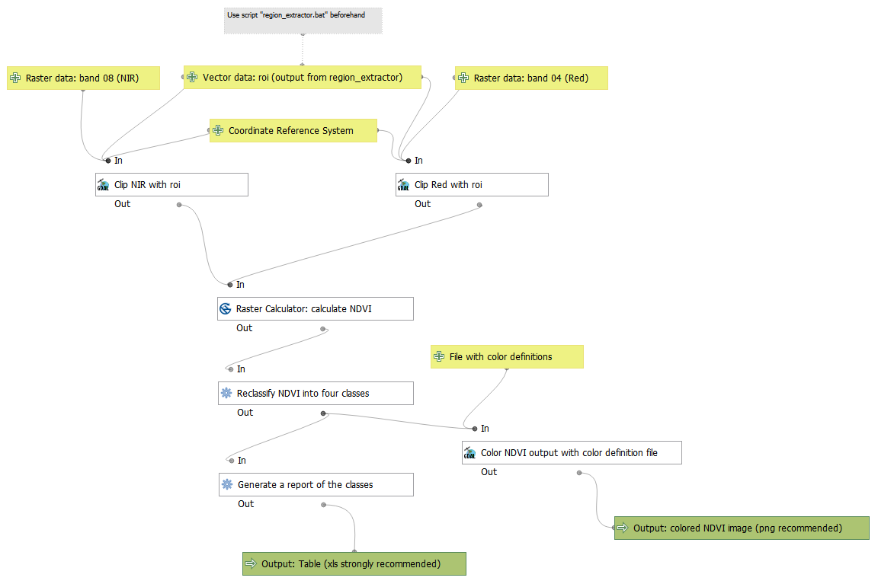
Notes:
Here you can see the whole model
And to visualize how it works we thought the best tool for it is a video and I'm going to show it to you guys right now:

Slide 16
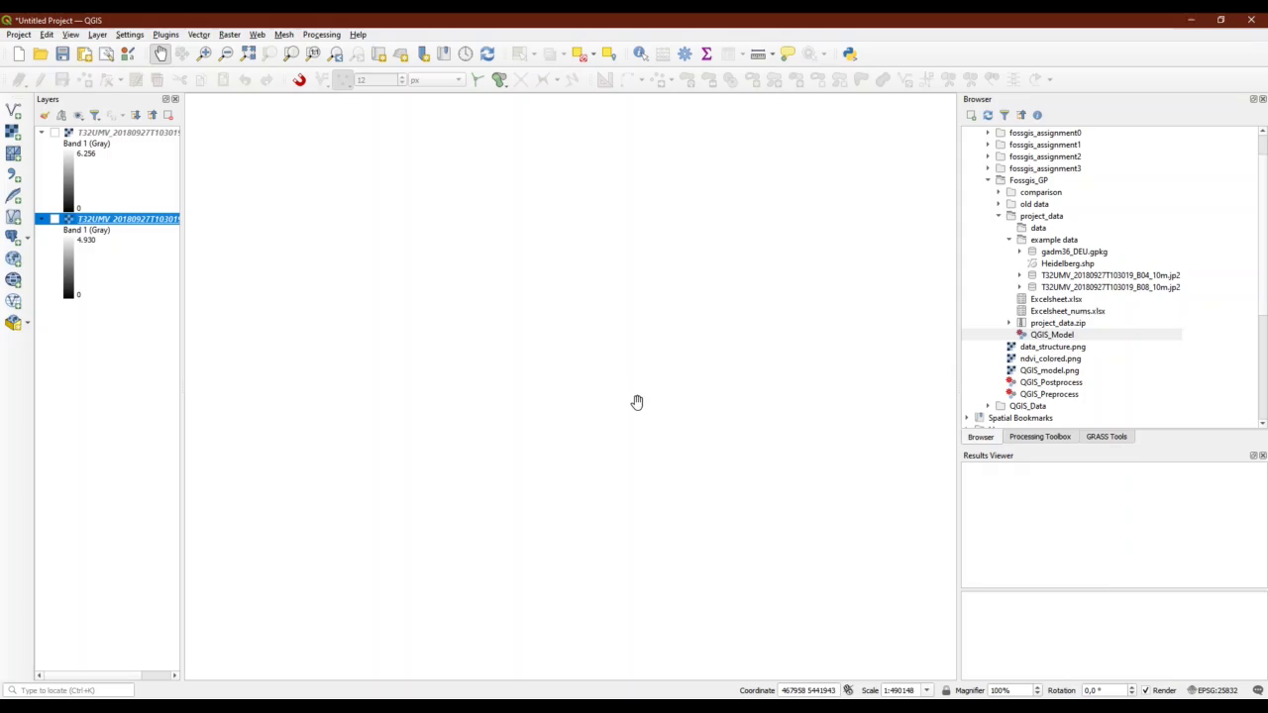

Slide 17
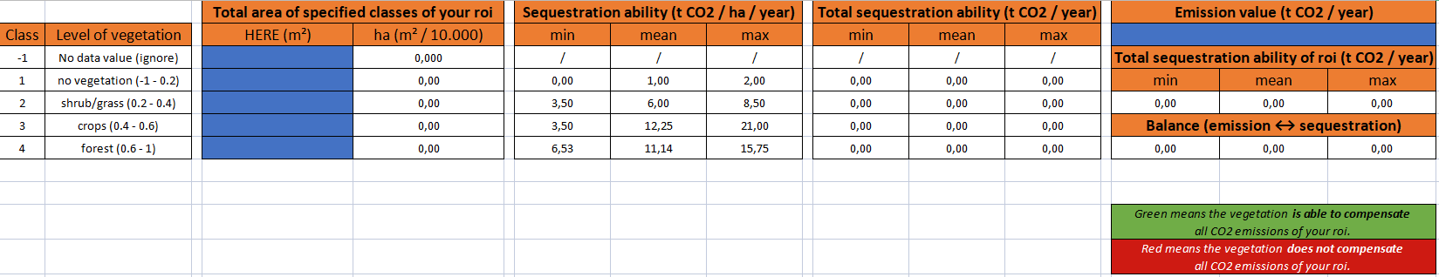
Calculations in Excel
Source: own figure
Notes:
- The next step is the calculation in spreadsheet/ Excel
- We prepared an Excel file with automatic conversions and calculations as you can see here
- You just need to paste in the values from the models´excel file into the left blue window and the emission value you got from openghgmap.net into the right blue highlighted window.-
If will the run the calculation automatically as you can see in the following:
> nP

Slide 18
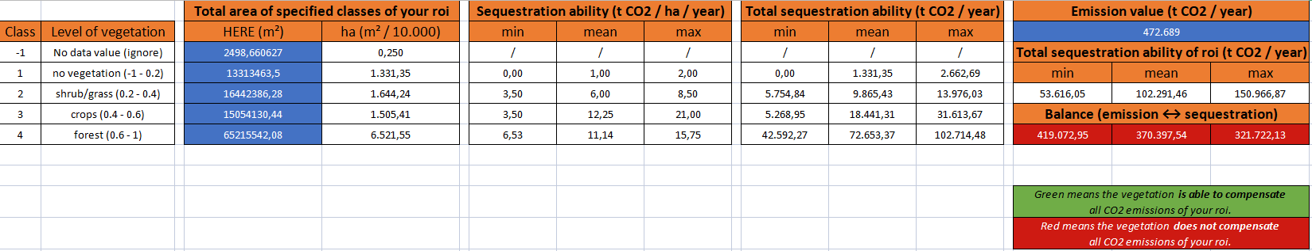
Results
Source: own figure
Notes:
-By the example with the values of Heidelberg you can see the balance between the total sequestration ability and the total emissions of co2:
- It shows generally if the vegetation is able to compensate the CO2 emission or not.
- As you can see the emissions are much higher than the total sequestration ability, so the balance window turns out to be red instead of green.
Of course we advice to check this model with comparable analyses.
- So one important thing to say is, that those values … -> nP

Slide 19


Discussion: problems/limitations
All values are estimated and not to be taken as scientifically proven
Data for sequestration not adequate for empirical statements – difficult to aquire data in the first place
No up-to-date data for CO₂ emissions (other sources needed)
BUT:
Model is applicable with other data → more accurate data leads to better results
Good tool for getting a first impression of the imbalance between emission and sequestration in a city's extent
Notes:
- Are estimated and the values are not to be taken as scientifically proven
- The reason for this is that the data for sequestration are not adequate for empirical statements –it was difficult to acquire data in the first place
(vegetation is very divers)
Another problem in the project was that the data for CO2 emission were not up-to-date. We did a workaround by using raster data from 2018 to make it comparable.
Further searching for current sources would be mandatory.(weiter)
BUT
Model is applicable with other data – the better the data, the better the results
Good tool for first impression

Slide 20






Outlook
Further compare the Raster Calculators (other GIS?)
Look for better data sources for sequestration and emission
Implement of roi_extractor.bat into the QGIS model
Automatically import results from model into the Excelsheet
Repository is finished, just needs updating if new implementations work
Notes:
Which Raster Calculator suits best to our model?
Better data – better results
Implement roi_extractor.bat file into model and Results could be imported into the excelsheet/spreadsheet automatically for higher degree of automation
Last but not least: Out Repository is finished: You should have a look into it: Step by step manual on how to run workflow with some other ressources such as videos etc.

Slide 21
List of sources
Mkansi, R. (2017): Spectral reflectance of soil, vegetation and water. - URL https://mkansireminder.wordpress.com/2017/04/24/spectral-reflectance-of-soil-vegetation-water/ [as of: 30.01.2022].
Zheng, Qiong & Huang, Wenjiang & Cui, Ximin & Shi, Yue & Liu, Linyi. (2018). New Spectral Index for Detecting Wheat Yellow Rust Using Sentinel-2 Multispectral Imagery. Sensors. 18. 868. 10.3390/s18030868.
https://www.d-copernicus.de/daten/satelliten/daten-sentinels/ (as of: 30.01.2022)
https://openghgmap.net/#Heidelberg,%20Baden-Württemberg,%20Deutschland (as of: 30.01.2022)

Slide 22

Thank you very much for your attention!
Notes:
This concludes our presentation of our group project
Thank you very much for your attention and if you have any questions ask right away

Slide 23
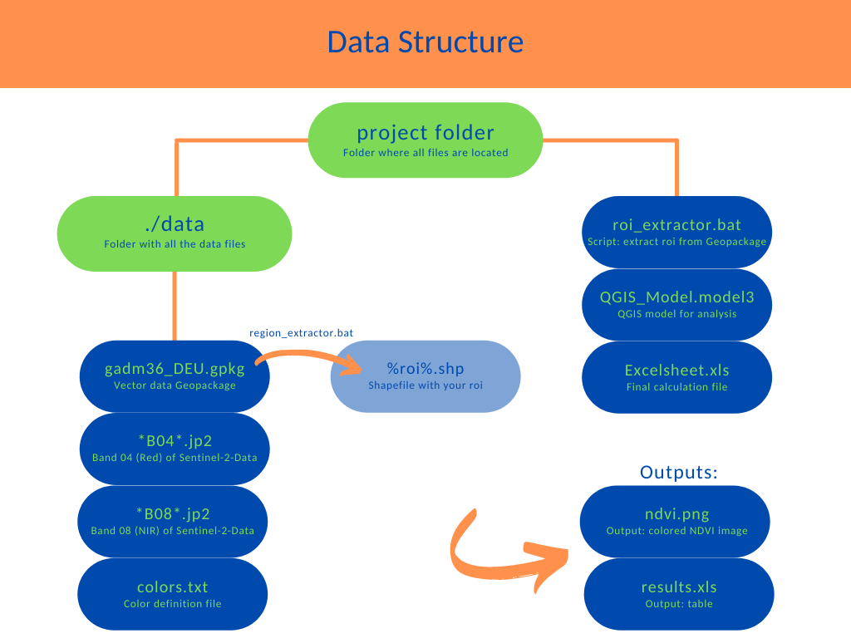
Structure of required data

